Slide 1
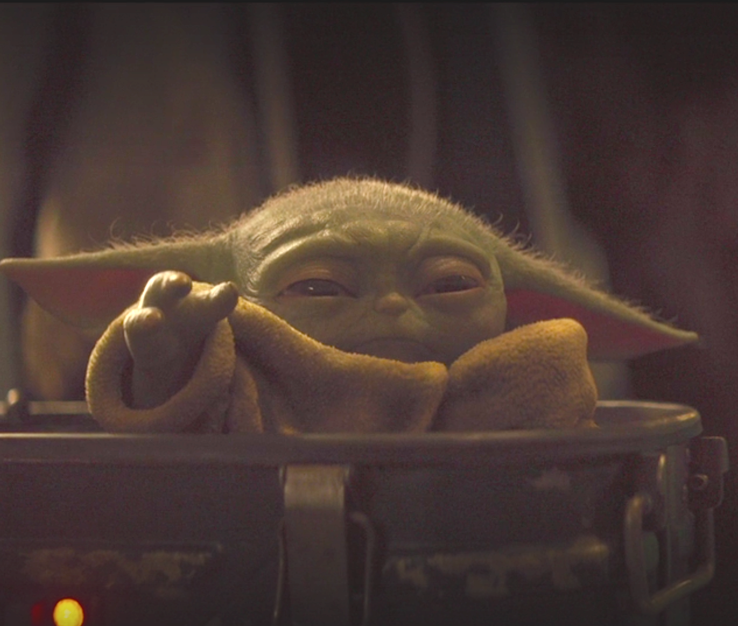

Baby Yoda Gone Robo!
Team Members
Peter Repetto
Junwei Luo
Ninoslav Vasic
Troy Draizen
Kevin Qui
Special Thanks to Jeff Slentz

Slide 2

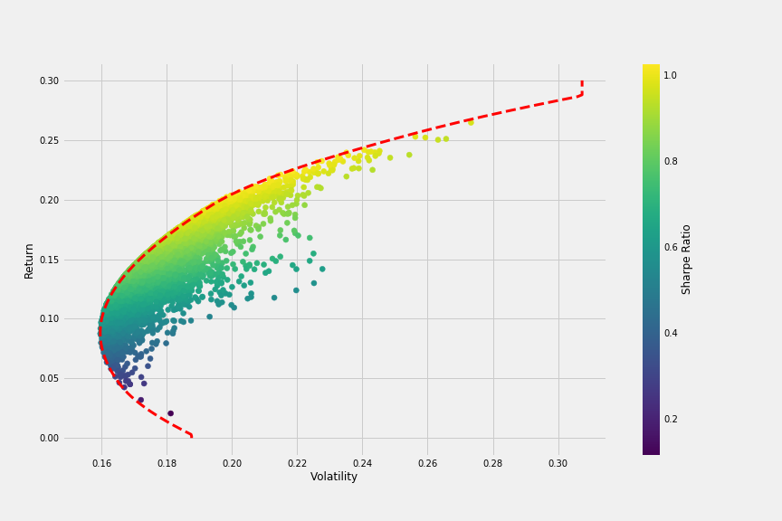
Simplified Investing Utilizing Efficient Frontier and Sharpe Ratio Optimizations ?
Does Anyone Know What That Even Means? Why Not Just Make it Simple
For Everyone?
Addressing The Real Issues of The American Dream!
~ 80% Of Americans Live Paycheck To Paycheck
2017 Survey Career Builder
70 % Of Americans Lack Basic Financial Knowledge
2017 Journal of Human Resources
1 in 4 Have No Retirement Savings
2019 Federal Reserve Report
“Be The Change That You Wish To See In The World”
Mahatma Gandhi

Slide 3
Questions & Data
Generate Portfolios using broad based ETF’s
Can we educate clients on retirement targets?
PyPortfolio Optimizer
How can we optimize portfolio’s with optimal weights?
Dashboard
Panels
Jupyter Notebook
How do we present the data given retirement goals?
IEX Finance
Bloomberg
Pandas
Python
Can we generate and optimize a portfolio based on retirement targets?

Slide 4
Data Cleanup & Exploration
Data Cleanup – Group Portfolios based on PyPortfolio Optimizer and Weights
Group Data Subsets (Fixed Income, Equity & Blended)
Insights: Constructing Portfolios
Generate Avg Returns
Generate Standard Deviations
Generate Sharpe Ratio’s
Generate Efficient Weights
Generate Call Functions for Dashboard
Issues
Cleaning data in proper form to be able to call function.
Generating a readable and elaborate Dashboard to reflect our overall theme of investing made simple.

Slide 5
Underlying Symbols for Portfolio Construction
NAME | Asset Class | Regional / Rating Focus | 1YR Return
VANGUARD S&P 500 VALUE ETF | Equity | North America | 19.35769
ISHARES MSCI EUROZONE ETF | Equity | Developed Market | 14.03402
ISHARES RUSSELL 2000 ETF | Equity | North America | 8.98753
VANECK SEMICONDUCTOR | Equity | North America | 50.30338
ISHARES NASDAQ BIOTECHNOLOGY | Equity | North America | 10.8099
UTILITIES SELECT SECTOR SPDR | Equity | Developed Market | 29.84456
VANGUARD S&P 500 GROWTH ETF | Equity | North America | 28.74284
SPDR S&P 500 ETF TRUST | Equity | North America | 24.1956
INVESCO QQQ TRUST SERIES 1 | Equity | North America | 38.71034
ISHARES MSCI BRIC ETF | Equity | Global | 12.11318
ISHARES MSCI EMERGING MARKET | Equity | Global | 7.34581
ISHARES ASIA 50 ETF | Equity | Global | 12.00665
ISHARES CORE U.S. AGGREGATE | Fixed Income | Investment Grade BBB or higher | 9.481697
ISHARES 20+ YEAR TREASURY BO | Fixed Income | Investment Grade A or higher | 21.62147
ISHARES 1-3 YEAR TREASURY BO | Fixed Income | Investment Grade A or higher | 3.555558
ISHARES 3-7 YEAR TREASURY BO | Fixed Income | Investment Grade A or higher | 6.830498
ISHARES IBOXX HIGH YLD CORP | Fixed Income | High Yield | 8.762668

Slide 6
Discussion & Presentation
Yoda 1: “The World is Your Oyster!” – Eat Pray Love across the world of investing and global diversification.
Yoda 2: “Play it Again Sam” - Invest In Uncle Sam and be conservative with your money, I mean who doesn’t trust a good government.
Yoda 3: “Bond James Bond” - High Quality corporate bonds with a touch of delicious dividends.
Yoda 4: “Have Your Cake and Eat it To” -This isn’t gramps 60/40 portfolio so listen up.
Yoda 5: “Show Me The Money” – You got a lot of risk here but you also have a lot of potential return, young Jedi!

Slide 7
The Portfolio Awakens (Data Preview)

Slide 8
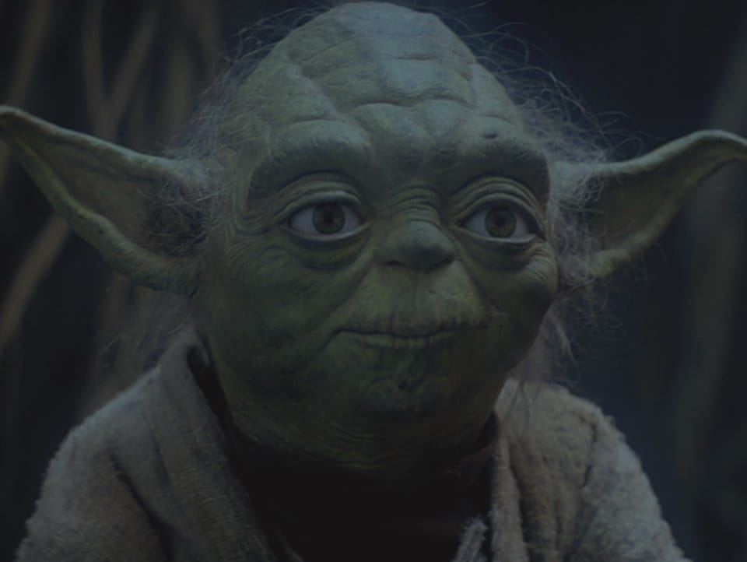
Questions?
“Fear is the path to the dark side.”
“Do or do not. There is not try.”
“The greatest teacher, failure is.”
“You must unlearn what you have learned”

